Slide 1
DevOps
Wezva Technologies

Slide 2



ARCHITECT
ADAM
TRAINER

Slide 3




Organization’s Needs ?
Continuous Delivery
Higher Quality
Lesser Spending
Reduced Outages

Slide 4




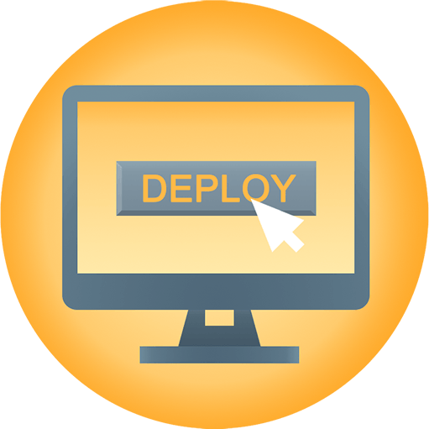

What Dev wants ?
dev
QA

Slide 5


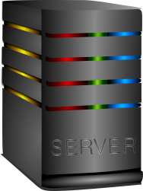


What Ops wants ?
sys
admin

Slide 6



The Solution
Communication
Collaboration
Automation
dev
ops

Slide 7



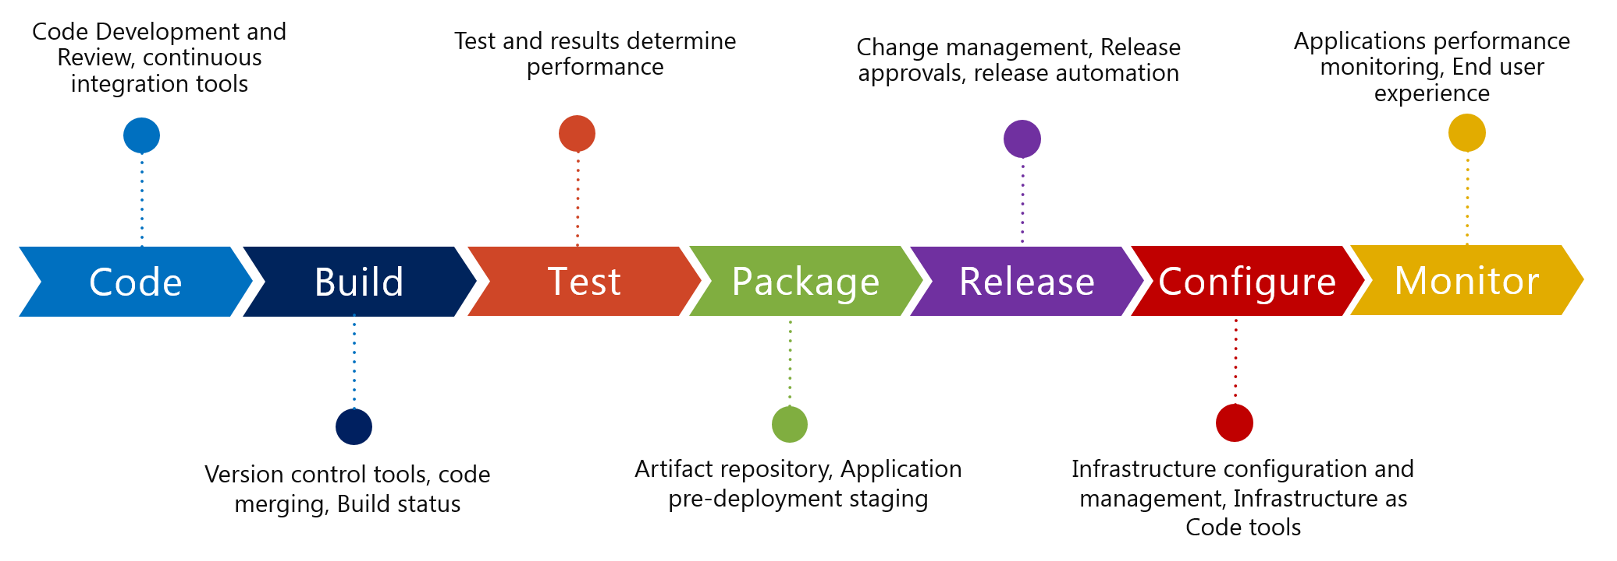
















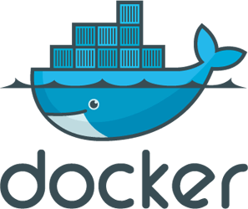
DevOps Workflow
Release
Configure
Operate
Operate

Slide 8

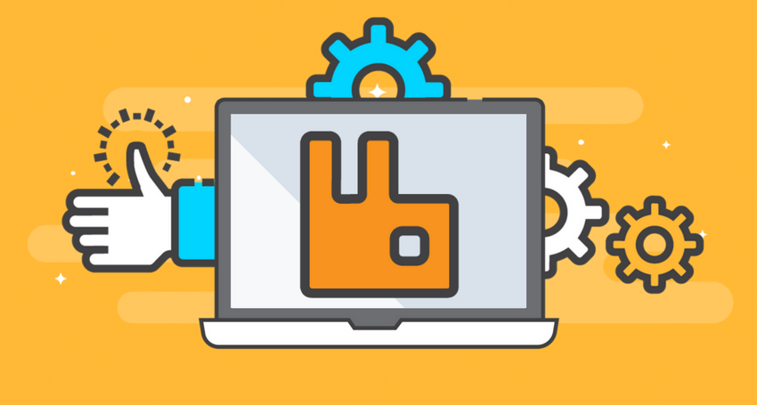



Characteristics of a Successful DevOps Culture
Generalist
Automation
Best Practices
Operational Excellence
Resilience

Slide 9
DevOps Lifecycle Phases
Continuous Development
Continuous Testing
Continuous Integration
Continuous Deployment
Configuration Management
Continuous Monitoring
SDLC

Slide 10
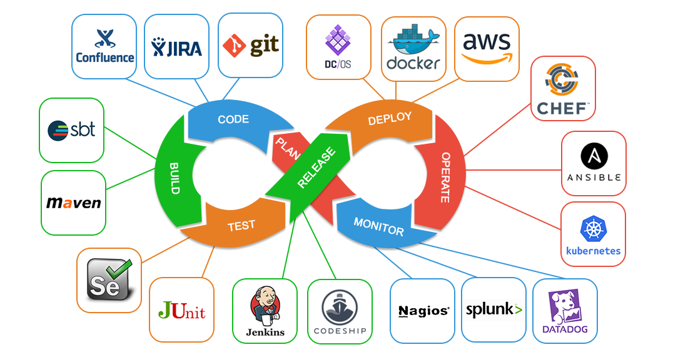
DevOps Tools

Slide 11
How to become a successful DevOps Engineer
Start cross-training now
Build the skills in the job you have for the job you want
Automate tasks
Community involvement

Slide 12




DevOps Learning Path:
For non-admins like Developer, QA, Middleware, Managers
Level | Skills Needed
Beginner | Basic Linux commands knowledge Good to have basic scripting knowledge (not mandatory)
Practitioner | Continuous Development Continuous Integration Continuous Delivery Continuous Testing Release Management
Proficient | Continuous Deployment Configuration Management Containerization
Champ | Deployment Orchestration Cloud Management Continuous Monitoring
Good to have | Python scripting, Collaboration skills
Champ
D
E
V
O
P
S
Proficient
Practitioner
Beginner

Slide 13
AWS Learning Path:
For admins like System Admin, Network Admin, Web Admin
Level | Skills Needed
Beginner | Basic OS troubleshooting knowledge Basic Networking knowledge
Practitioner | AWS Cloud Practitioner AWS Developer
Proficient | AWS Solutions Architect - Associate AWS Sysops Administrator
Champ | AWS Certified Solutions Architect – Professional AWS Certified Devops engineer - Professional
Orchestration | Terraform, Openstack
Good to have | Python Scripting
Champ
D
E
V
O
P
S
Proficient
Practitioner
Beginner

Slide 14
Salary Range for DevOps Engineers:
40+LPA
30LPA
23LPA
2X
3X
0 - 5
Years
5 - 10
Years
> 10
Years
4X

Slide 15




Questions
Queries
Feedback
9739110917 / 7892017699
Email: mailme@wezva.com

Slide 16
DevOps Curriculum:
Modules
OS Essentials
Version Control System
Build Management
Continuous Integration
Configuration Management
Containerization
Deployment Orchestration
Cloud Computing
Infrastructure As A Code
Extras
Scripting
Monitoring

